Slide 1
LOCATION OF RESTUARANT
Submitted by,
Arshitha Femin

Slide 2
INTRODUCTION
In this project, we will try to find an optimal location for a restaurant in Stockholm, Sweden.
We have to build a restaurant in Stockholm,Sweden.
We have to locate the areas which have less resturants,ie least crowded area.Inorder to get profit in an area,
We have to locate areas with least or no restuarants nearby.
We will collect maps and data and will use our data science to find the appropiate location.

Slide 3
Data
Data title: - Open Data published by Government of Sweden under the section HM Land Registry: Location Data Type of data: Dataset in form of CSV file Duration: August 2018 data
Location Data includes information on all property sales in Sweden and Stockholm that are sold for full market value and are lodged with us for registration. The dataset includes the transactions received at HM Land Registry in the period from the first to the last day of August 2018.

Slide 4
• Data title: Google Maps Geocoding API
Type of data: JSON
Duration: N/A
Description of the data: Location coordinates obtained by Gmaps API calls. Location Information obtained is used to obtain the location coordinates from Google Maps. A separate Python script has been developed to extract the unique street names, district names from the Dataset and embed those in the GMaps API calls to obtain the required information.

Slide 5
Google Cloud Platform/ Google Maps• Data title: Restaurant location data
Description of the data: Location coordinates obtained by Foursquare API calls. To determine the proximity of various amenities as per the client’s requirement, restaurant location data is used.

Slide 6
2. Data acquisition and cleaning
Based on definition of our problem, factors that will influence our decision are:
Number of existing coffee shop in the neighborhood (including restaurant offer coffee), number of and, distance to other coffee shop/restaurant in the neighborhood, if any, distance of neighborhood from city center.
Number of coffee shop and their type and location in every neighborhood will be obtained using Foursquare API, coordinate of Stockholm center will be obtained using Google Maps API geocoding

Slide 7
Data Requirements and Methodology
Data Acquisition Approach To acquire the data mentioned above, we need to do the following:Getgeolocator latand long coordinates for Stockholm, Sweden,useFoursquare API to get a list of all venues in Stockholm,getvenue name, venue ID, location, category, and perference.

Slide 8
METHODOLOGY
The thought process behind this is that likes are a proxy for quality. The more likes there are, the better the restaurant is. This might be incorrect but API call issues (how many I can use for free) holds me back from getting price / rating data. We will then bin this data into a quality categorical variables so we can cluster appropriately.

Slide 9
Results
Our analysis shows that although there is a great number of restaurants in Stockholm, there are pockets of low restaurant density fairly close to city center.Anotherborough was identified as potentially interesting but our attention was focused on offer a combination of popularity among tourists, closeness to city center, strong socio-economic dynamics and a number of pockets of low restaurant density.

Slide 10
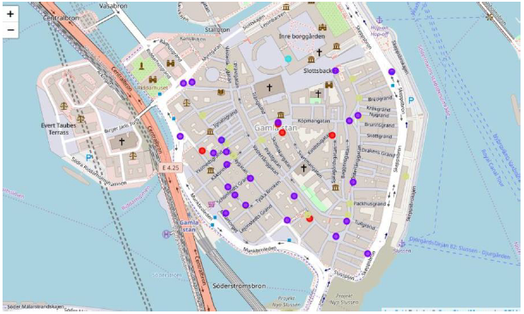

Slide 11
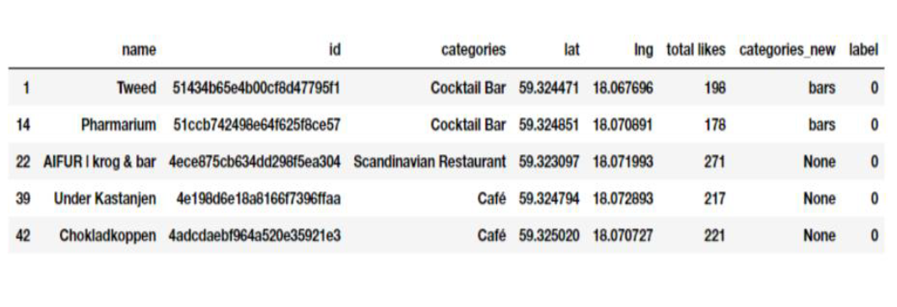
C1

Slide 12
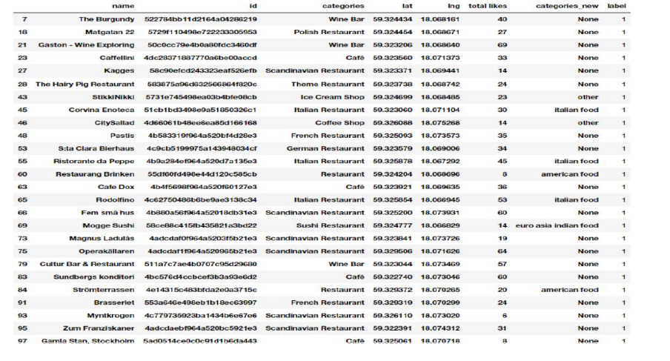
C2

Slide 13
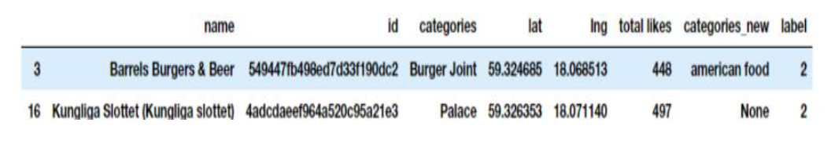
C3

Slide 14
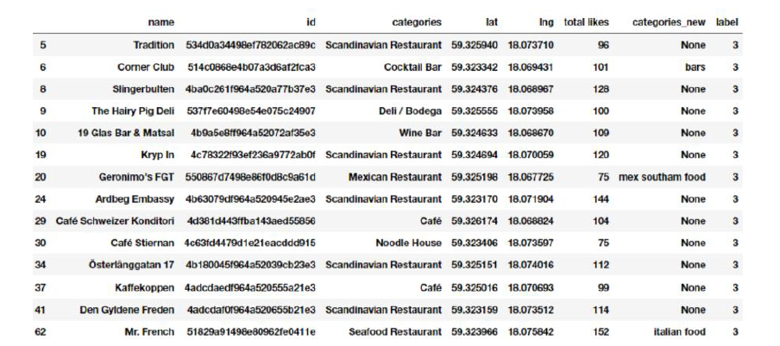
C4

Slide 15
CONCLUSION
Final decision on optimal restaurant location will be made by stakeholders based on specific characteristics of neighborhoods and locations in every recommended zone, taking into consideration additional factors like attractiveness of each location.

